Slide 1
Big Mountain Resort Operation Report
Author: Gexin Chen
Date: 02/04/2023

Slide 2
Problem Identification
Big Mountain Resort has installed an additional chair lift, causing $1540000 extra operating cost.

Slide 3
2. Data Insight
What are important factors deciding ski resorts’ ticket value?
Ticket price is highly correlated to these features: summit elevation, vertical drop distance, total number of chair lifts, total number of runs and total number of fast Quad chair lifts.
Our random forest model suggests vertical drop distance, total number of fast Quad chair lifts, total number of runs and snow making coverage are importantly influential on ticket price.

Slide 4
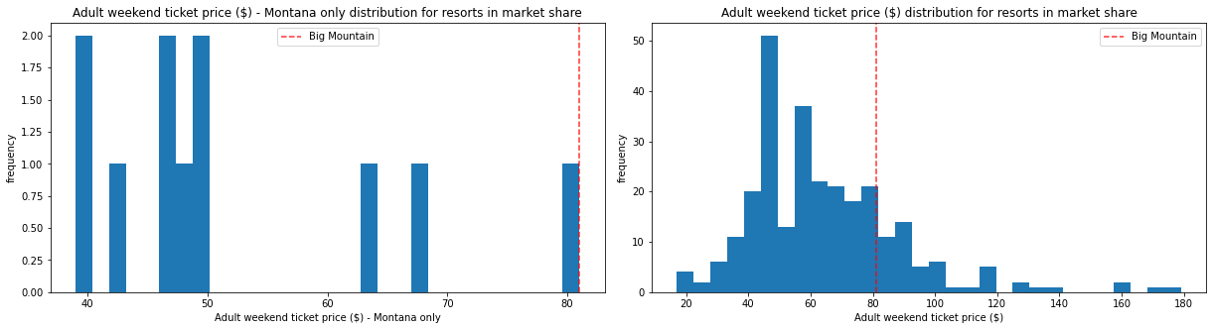
2. Data Insight
Big Mountain Resort is one of the best resorts all over the United States in terms of resort facilities and skiable area coverage. It is also the most expensive resort in Montana.

Slide 5
3. Price Modeling
4 business options are provided:
Permanently closing down up to 10 of the least used runs;
Increase the vertical drop by adding a run to a point 150 feet lower down and an additional chair lift;
Based on option 2, add 2 acres of snow making coverage;
Increase the longest run by 0.2 mile and additional 4 acres of snow making coverage.

Slide 6
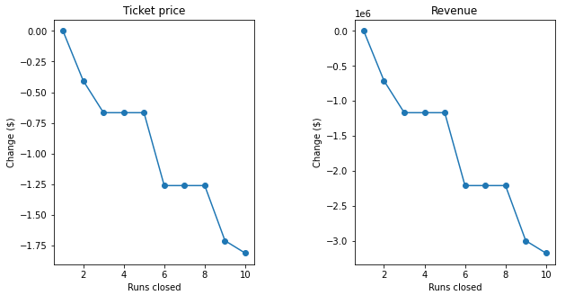
3. Price Modeling
X-axis represents the number of runs closed, while Y-axis represents the change of ticket price and total revenue respectively.
Under business option 1, closing 5 runs is the best choice.
We assume the total number of day tickets sold is fixed at 1.75 million.

Slide 7
3. Price Modeling
 | Modeled Price | Price Change | Revenue Change | Operating Cost Change
No Action | $95.87 | — | — | —
Option 1 (5 runs closed) | $94.61 | -$1.26 | -$1.2M | -$7.7M
Option 2 | $97.86 | $1.99 | $3.47M | $1.54M
Option 3 | $97.86 | $1.99 | $3.47M | Over $1.6M
Option 4 | $97.86 | $1.99 | $3.47M | Over $2M
We assume the total number of day tickets sold is fixed at 1.75 million and operating cost of a single chair lift is 1.54M on average.

Slide 8
4. Conclusion
Big Mountain Resort is already the best and most expensive resort in Montana, further investment on facilities forces us to further increase ticket price which would probably cause demand decrease;
Prediction model suggests that our current ticket price is undervalued in current market;
Prediction model suggests that closing several runs will not decrease our ticket value a lot, and closing runs can help us save a decent amount of money.
Therefore, from my own perspective, we recommend Big Mountain Resort to permanently close 5 runs and keep the ticket price as what it is.

